Slide 1

Software Selection Assessment

Slide 2
Software Selection Methodology & Approach
12 Step Approach
Step 1: Current Requirements Analysis
Step 2: Best Practices Template Checklist
Step 3: Shortlist Selection of Suppliers
Step 4: Procurement process support and scripted demo setup
Step 5: Execution of supplier scripted demonstrations
Step 6: Numerical scoring of solutions demonstrated
Step 7: Program budget creation
Step 8: Detail cost savings definition
Step 9: Program master schedule development
Step 10: Internal Rate of Return analysis
Step 11: Final executive summary and presentation
Step 12: Change Management

Slide 3
12 Step Assessment Approach
12 Step Approach
Step 1: Current Requirements Analysis
Step 2: Best Practices Template Checklist
Step 3: Shortlist Selection of Suppliers
Step 4: Procurement process support and scripted demo setup
Step 5: Execution of supplier scripted demonstrations
Step 6: Numerical scoring of solutions demonstrated
Step 7: Program budget creation
Step 8: Detail cost savings definition
Step 9: Program master schedule development
Step 10: Internal Rate of Return analysis
Step 11: Final executive summary and presentation
Legend:
Completed in Task 1a
Steps to be Completed in Task 1b
Step 12: Change Management

Slide 4
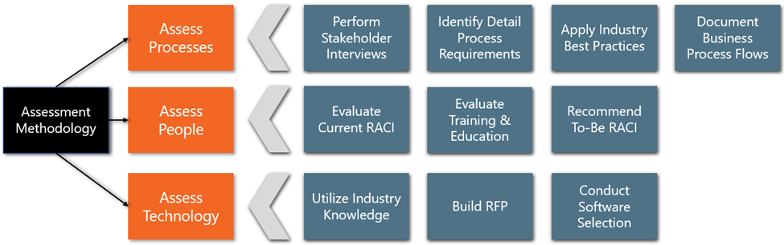
Assessment Capabilities
Our team has developed an effective approach/methodology in evaluating software solutions for our customers over the past two decades. This methodology has been proven in some of the most complex and sophisticated business environments around the world and has effectively served many small to medium sized business environments as well. Our approach is pragmatic and has been proven through senior levels of management decision making in solution selection, project justification, and program planning for across numerous public and private sector clients.
Our team believes in a wholistic assessment approach based on People, Process & Technology

Slide 5



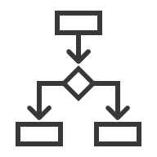








Step 1: Analyze 6 Business Dimensions
Our team will leverage our Business Transformation Framework to decompose an organization’s current state operating model. As part of the future state definition, we reassemble the components into to-be Operating Model.
Strategy & Structure
Process
Strategy & Structure
Analyzes how company goes to market, which channels are used & how products/services flow through the value chain from vendors, manufacturing, through distribution centers & customers
Process
Inventories all the relevant business processes performed by an organization, identifies how they are linked, lists which activities & tasks are performed by whom
Business
Enablement
Digital & Technology
Governance
Governance
Evaluates management, policies, decision rights & ways of working & operating cadence
Digital & Technology
Analyzes technology deployed, how it’s leveraged, & what digital infrastructure is in place to provide a sustainable environment to support the operating model
Organization & Change
Data
Organizations are managed by people performing roles in departments within specific organizations. We analyze org structures, evaluate capabilities, understand incentives & culture, while considering the impact of change
Organization & Change
Data
Evaluates state of data quality, management, and governance to support required decision-making, tools, processes, and outcomes
Realize, Measure, & Sustain Benefits
Analysis anchored to the Process Framework

Slide 6
Assess
Selection of best practices template checklist for business environment being assessed
Step 2:
Best Practices Template Checklist
Organize
Templates are organized by major run modules with sub function definition
Outline
Technical architecture templates include data base/file management requirements, network requirements, and processing environment requirements

Slide 7
Fit/Gap Analysis
Go/No-Go Checkpoint
Fit/gap analysis of functional and technical requirements utilizing data from section I and II above
Major go/no go requirements for business environment being assessed, go/no go checkpoint 1
Step 3: Short
List Selection
of ERP Vendors
Requirements Review
System Down-Select
Utilize requirements doc as a primary sift in step one of down select
Select 2-4 systems that rank highest in fit/gap analysis as the next sift in down select

Slide 8
Step 4: Procurement Process & Scripted Demo Support
Procurement Strategy
Finalize Strategy
Define procurement strategy
Finalize terms and Conditions based on procurement strategy
Leverage Templates
Develop A Plan
Utilize functional process templates from best practices modified by unique requirements discovered
Develop special instructions and timing for scripted demonstrations
Consolidate Data
Procurement Package
Develop actual data from customer and package to fit scripted demonstration
Finalize procurement package combining 4(B) through 4(E) above and deliver to potential suppliers

Slide 9
Step 5: ERP Vendor Scripted Demo Execution
Prepare
Prepare demonstration environment as specified provided in procurement package
Schedule
Schedule suppliers for demonstrations from blind draw order for 2-5 days depending on complexity of solution being assessed
Finalize
Finalize functional and technical team from customer to evaluate scripted demonstration
Administer
Administer scripted demonstrations
Identify
Identify add on software required for gaps discovered in demonstrations

Slide 10
Handout scoring worksheets along with instructions to the team lead from each functional and technical area
Aggregate results and post to team after each scripted demonstration is completed
Lead a structured analysis group to discuss final numeric scores and allow for each area to make numeric adjustments
Create final summation sheet and have each functional/technical force rank the demonstrated solutions based upon their assessments.
Present results to the functional & technical leads and obtain sign off from each area, present the selection to executive management and procurement
Step 6: Scoring of ERP Vendor Demo

Slide 11
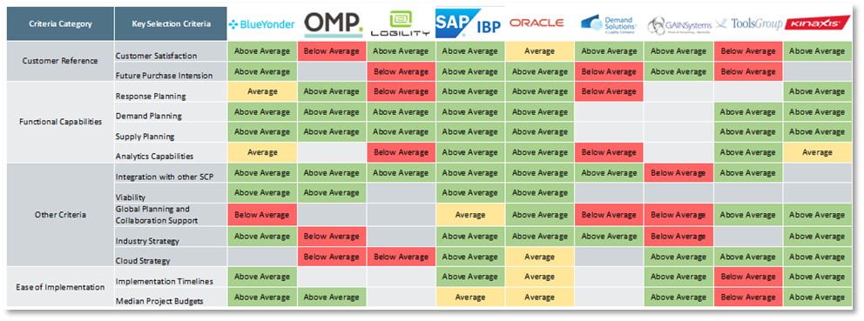
Step 6: Scoring of ERP Vendor Demo- Example
Example – High-level solution evaluation matrix for initial list of solutions

Slide 12
Step 7: Budget Creation
Model
Model detail cost using inside/outside costing template all-inclusive cost using “should cost” model
Create
Create option cost template for outside/inside tradeoffs (i.e. cloud hosting vs. inside computing)
Validate
Validate costs from outside suppliers through preliminary negotiations
Reset
Reset detail cost model from outside data receipt
Present
Present budget requirements to executive management for go/no go checkpoint 2 and sign off

Slide 13
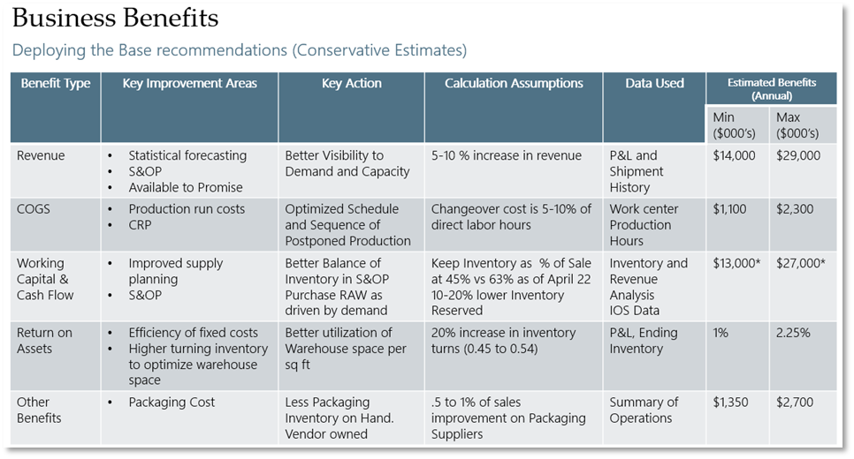
Step 7: Budget Creation- Example
Example – Business Case Based on Key Value Drivers

Slide 14
Step 8: Detailed Cost Saving Definition
Create
Create cost savings template for each affected functional department and information technology, categorize cost savings by 1. Cost reduction 2. Cost avoidance 3. Growth cost impact
Validate
Field analysis of cost savings through department interviews, technology sizing, and industry benchmarking
Present
Present departmental cost savings to each department head (if agreement cannot be reached) repeat 8(b) for validity check and gain sign off
Consolidate
Consolidate cost savings in intradepartmental savings intersection and complete savings template

Slide 15
Step 9: Master Schedule Development
Utilize multi-trac program plan or agreed to customer approach to fill out functional areas to be scheduled depending on project scope and industry type
Agree and get sign off from customer on total project implementation duration
Develop deployment strategy and implementation sequencing
Create additional steps that are truly unique do to technology, functional, and/or volume and integrate into to base plan
Present integrated master schedule for executive management sign off

Slide 16
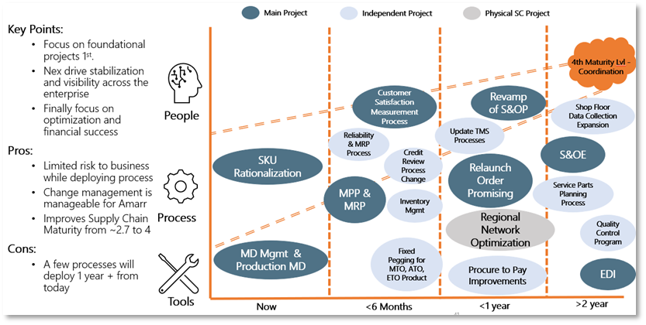
Step 9: Master Schedule Development- Example
Example – Prioritized Roadmap and Timeline

Slide 17
Step 10: Internal Rate of Return Analysis
Consolidate Budget Cost savings templates across master schedule timeline into IRR model
Set rate and inclusion assumptions for IRR calculation
Obtain sign off rates and assumptions from Chief Financial Officer or most Senior Financial Officer responsible for project
Run final IRR calculation
Obtain IRR sign off from senior executives Go/No Go checkpoint 3

Slide 18
Step 11: Executive Summary & Presentation
Prepare final presentation
Final executive presentation and sign off Go/No Go checkpoint 4 (Final)
Hold preliminary review with project team

Slide 19
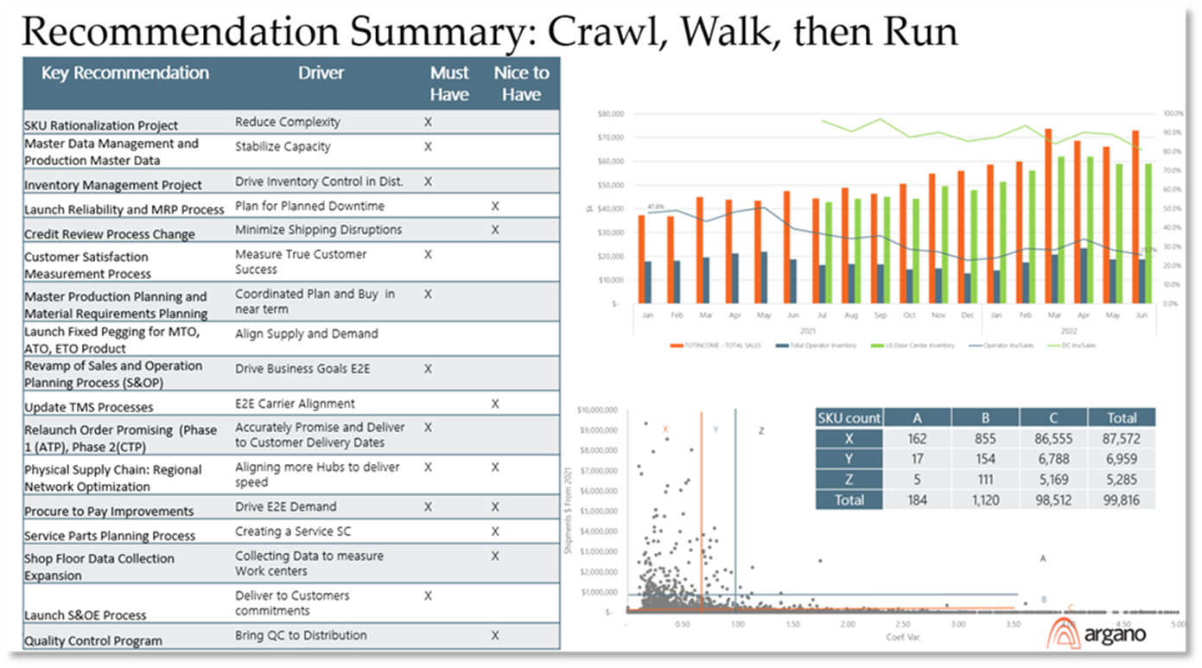
Step 11: Executive Summary & Presentation
Example – Executive Summary

Slide 20
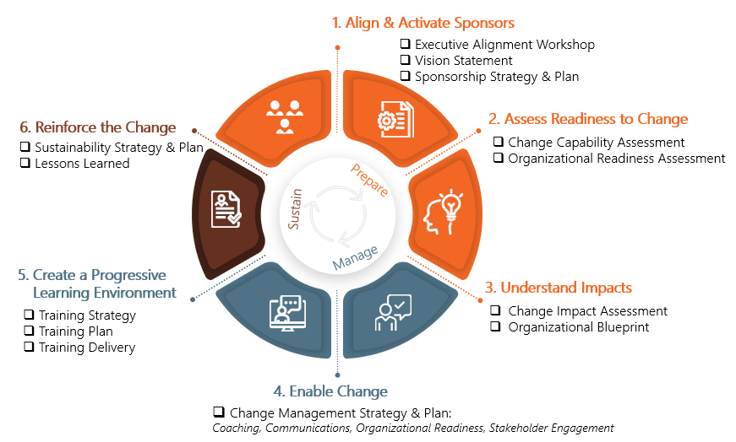
Step 12: Change Management (Throughout The Process)

Slide 21
Next Steps

