Slide 1

Business Initiative & ROI Performance Health Check

Slide 2





How Will We Perform The Program Health Check?
GOVERNANCE ASSESSMENT
Review Program Governance Framework focused on the six business dimensions
Alignment with Organizational and Business Strategy
INTERVIEWS & WORKSHOPS
Facilitate workshops to clarify organizational objectives
Attend ongoing program leadership meetings and review observations to date
BUSINESS TRANSFORMATION FRAMEWORK
Baseline for assessing the status and readiness of the program.
CHANGE MANAGEMENT CHECK
Assess Project Health in the areas of Governance and with a strong focus on the six steps to successful Change Management
EXECUTIVE READOUT
Executive Summary of Risks, Recommendations and Approach to incorporate recommendations into the current engagement.
Governance Assessment
Executive Readout
Change Management
Executive Alignment Workshop & Interviews
Program Readiness

Slide 3
Feedback Heat Map
Heat Map results from interviews and workshops with all initiative stakeholders within the client organization
Deliverables
Risk Control Matrix
Identified risks of each phase of initiative
Details of internal controls which will mitigate each risk identified
Executive Assessment & Findings Document
Our team will summarize recommendations and approach in a high-level PowerPoint document

Slide 4



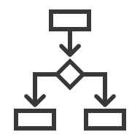








Evaluation Approach: Analyze 6 Business Dimensions
Our team will leverage our Operational Transformation Framework to decompose and rebuild the current business operating model.
Strategy & Structure
Process
Strategy & Structure
Analyzes how company goes to market, which channels are used & how products/services flow through the value chain from vendors, manufacturing, through distribution centers & customers
Process
Inventories all the relevant business processes performed by an organization, identifies how they are linked, lists which activities & tasks are performed by whom
Business
Enablement
Digital & Technology
Governance
Governance
Evaluates management, policies, decision rights & ways of working & operating cadence
Digital & Technology
Analyzes technology deployed, how it’s leveraged, & what digital infrastructure is in place to provide a sustainable environment to support the operating model
Organization & Change
Data
Organizations are managed by people performing roles in departments within specific organizations. We analyze org structures, evaluate capabilities, understand incentives & culture, while considering the impact of change
Organization & Change
Data
Evaluates state of data quality, management, and governance to support required decision-making, tools, processes, and outcomes
Realize, Measure, & Sustain Benefits
Analysis anchored to the Process Framework

Slide 5
Examples of
Health Check Deliverables
BUSINESS INITIATIVE & ROI PERFORMANCE HEALTH CHECK

Slide 6


Example- Overview of Findings
Need For A Comprehensive Strategy Including:
Critical Recommendations:
Updated Project Plan
Change Management Plan
Engage Training Often and Early
Developed Processes
Project Governance
Communication Plan
Detailed Plan for Data Preparedness
Dedicated Digital Transformation Team
  Establish Governance Frameworks
  Oversee Digital Initiatives
  Ensuring Alignment with Goals for the Entire Organization
Dedicated Change Management Team
  Drive Communication
  Direction
  Planning from the Executive Level to the Associates

Slide 7
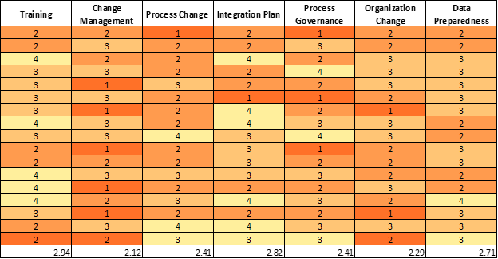
Example - All Stakeholders Heat Map
We asked each stakeholder to rank several fundamental components of the six business dimensions on a scale from 1-5 (1 lowest score and 5 best score).

Slide 8
-Training Ranked The Highest Through Out All Stakeholders
-Change Management
Ranked The Lowest
  Lack of Direction
  Communication
  Overall Program
  Need a better program to help drive and stabilize current and future projects.
Example - Heat Map Cont.
Important to note that all other areas ranked below a 3. All areas need focus and attention to drive engagement, ownership and success of this project and future projects.

Slide 9
Example - Transformation Recommendations
Project Plan
Assigning a Project Manager that manages all tasks for completion.
Meeting facilitation and management to ensure critical decisions are made quickly to keep the project moving forward.
Holding a new project kickoff meeting with all project team members to clearly articulate the vision, planned business outcomes and critical path of the project to build excitement and momentum.
Project Status meetings that include all work stream leaders need to be set on schedule three days a week but no less than weekly. In these meetings discuss:
Contingency planning
Any changes that need approval for the Change Control Board
Updates on the project tasks and daily activities (Scrum Meeting)
All Hands Meeting with employees that are involved, leaders, executive team, and stakeholders to give monthly or quarterly updates on the project and next steps. This will build excitement with the teams and help hold everyone accountable.
Set up a bi-weekly or monthly steering committee meeting with project management and executive sponsors to report on project status, roadblocks that cannot be solved at the project level, and to keep executive sponsors engaged in the project. The executive sponsors should also be holding the project status and activities to the vision and goals of the project.

Slide 10

Change/Process/Integration/Organizational Management
To promote user adoption and acceptance, Redhawk is proposing formalizing and incorporating a change management leader/team and workstream. The most effective culture change evaluation requires planning before the initiative and must consider following five points:
Change management includes all the systems, structures and processes that must be put in place to support the business strategy, whereas the change leadership deals with people such as leadership mindsets, behaviors and capabilities that are required to enact the business strategy.
To have a successful Change in any company you must gain staff buy-in to the new plan. Listen to what your employees at Jackson have to say and evaluate all feedback. You will have employees that are resistant to change, make sure to have a plan in place to respond to these issues that arise when they push back.

Slide 11
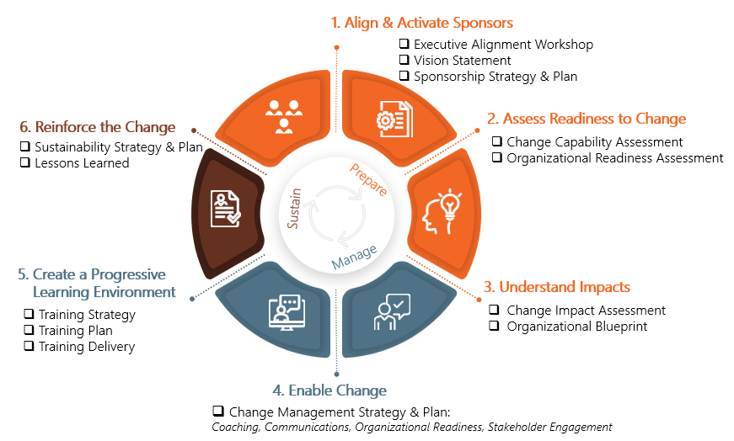
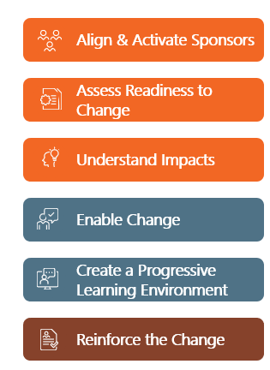
Our Change Management Approach
6 Steps to Ensure Successful Change

Slide 12
Example- Proposed Next Steps
Our team will assist in the implementation of a Change Management team to ensure this project hits the milestones, objectives and timelines of this project.
We will utilize our Change Management approach to implement and govern the Change Management team. This team will focus on these key areas:
    Build out a sponsorship strategy, written plan, and workshops for training.
    Assess Readiness to change assessing organizational and capabilities to change.
    Gather the impacts of the change and prepare the teams.
    Coach, Communicate, set up readiness, and engage key stakeholders.
    Work with the training team to create a strategy, plan and deliverable.
    Reinforce the change strategy and build off lessons learned when moving forward.

Slide 13
Next Steps

