Slide 1



Brand
Guidelines
eGroup Enabling Technologies 2025
ENABLING TECHNOLOGIES

Slide 2
TABLE OF CONTENTS
OUR STORY
03
ICONS
24
BRAND VOICE
12
COLORS
26
FONTS
13
SOCIAL MEDIA
30
LOGOS
16
EMAIL SIGNATURES
33
Please note the Table of Contents is clickable to jump to each individual section.
Click on the titles on each page to open the folder in the Team Marketing Files where these assets can be located.

Slide 3
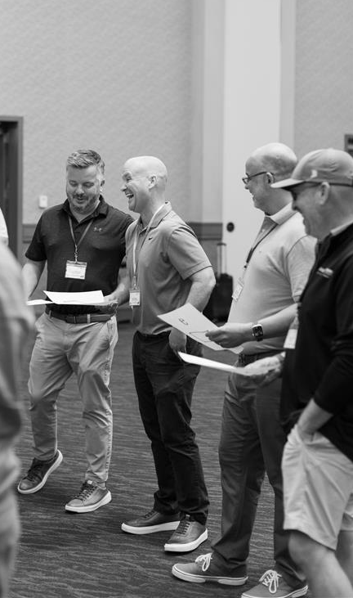
ABOUT US
Who is eGroup Enabling Technologies?
eGroup Enabling Technologies is a leading provider of IT solutions and an award-winning Managed Services Provider, specializing in empowering organizations to leverage technology for business success. With a team of experts and a client-centric approach, our team offers a wide range of services, including cloud, hybrid data center, security, data and AI, collaboration, and managed services.
Our commitment to excellence and passion for delivering exceptional results has established our company as a trusted partner for businesses seeking to harness the power of technology.

Slide 4

Our mission is to empower businesses to unlock the full potential of technology and achieve their goals through innovative solutions, while promoting sustainable practices and ethical conduct for the benefit of our stakeholders and the global community.
MISSION STATEMENT
MISSION STATEMENT
eGroup Enabling Technologies

Slide 5
Our guiding principles reflect the values that influence how we work together, serve our clients, and conduct business every day.
S
SENSE OF URGENCY - “Do it now.”
CORE VALUES
T
THOUGHT LEADERSHIP - “5 minutes in planning saves 15 in the field.”
R
RESPONSIBILITY - “The right way is not always the easy way.”
I
INNOVATION - “Faster, better, cheaper.”
V
VISION - “Seeing and advising on the road ahead.”
E
EXECUTION - “Delivering what we said we would deliver.”

Slide 6















Award Badges
9x Partner of the Year
  2021 Global Partner of the Year
  Nutanix Premier Partner
  Professional Services Authorized Partner
  2022 Carolinas Select Partner of the Year
2019 Cloud Partner of the Year
9th Consecutive Year
15th Consecutive Year
13th Consecutive Year
Multi-Year Winner
2024 Power Partner
Multi-Year Winner
Multi-Year Winner
2024 HSP 250 List
Fastest Growing Companies in SC
2019 - South Carolina

Slide 7
Our Key Differentiators
  9x Microsoft Partner of the Year
  6 Solution Partner with Microsoft
  Year-Over-Year 98%+ Customer Satisfaction Score
  30+ Years of Experience
  Strategic Advisory Services
  Award-Winning Organizational Change Management Team
  The Managed Services Team is US-based and comprised of all internal employees
  Our Managed Security Services Team customizes response mechanisms (integrate vs. overwrite) with the client's current operations and processes
  Nutanix Premier Partner
OUR MICROSOFT ADVANCED SPECIALIZATIONS
AI Business Solutions
  Teamwork Deployment​
  Calling for Teams​
  Endpoint Management
  Organizational Change Management
Security​
  Information Protection & Governance​
  Threat Protection​
  Identity & Access Management​
  Cloud Security
Cloud & AI Platforms
  Azure Virtual Desktop​
  Azure VMware Solution
  Infra and Database Migration to Azure

Slide 8
Our Key Differentiators & Phrases (Explained)
“9x Microsoft Partner of the Year”
“30+ Years of Experience...”
Read as “Nine-time Microsoft Partner of the Year.”
Read as “Thirty plus years of experience in...”
Whenever writing materials that highlight our Partner of the Year accomplishments, be sure to write it in this fashion. Refrain from saying things like, “We were a Microsoft Partner of the Year,” unless in the context of a specific solution (i.e., Teams Calling).
Say it with pride!
Including the number of years of experience in our communication helps us establish credibility and expertise, showcasing a track record of successfully implementing IT solutions for our clients’ specific business needs.
“Award-Winning Organizational Change Management Team”
“Strategic Advisory Services”
Our OCM team is passionate about bridging the gap between technology and those who use it, while equipping individuals to successfully navigate and adopt any change. By reiterating in our communication that they are award-winning, this emphasizes that they have a proven track record of success in their craft.
Our team provides strategic IT leadership and guidance to clients enhancing the client's technology decision-making. This also positions us as a trusted partner, emphasizing our success in aligning IT strategies with broader business objectives.

Slide 9
Our Key Differentiators & Phrases (Explained)
“Speed and Certainty”
“Getting Cloud Right the FIRST Time”
Delivering "speed and certainty" to clients means providing prompt and reliable results or solutions, and ensuring that our clients can confidently count on the agreed-upon outcomes or services within the expected timeframe. We use this phrase as a reference to the customer service, results, and partnership they commit to when partnering with us.
Getting Cloud Right the FIRST time means effectively planning and implementing cloud solutions from the start– avoiding costly and disruptive mistakes, and ensuring that the chosen cloud architecture aligns with the organization's long-term goals, security, and scalability needs. This emphasizes the importance of a well-thought-out strategy and execution to maximize the benefits of cloud technology while minimizing risks and setbacks.
The Managed Services Team is US-based and comprised of all internal employees
“98%+ Year-Over-Year Customer Satisfaction Score”
By delivering our services with US-based internal employees, we can provide a more consistent and higher quality customer experience, enhanced data security and compliance adherence, quicker communication and responsiveness, higher trust and accountability, and greater customization and flexibility in tailoring services to local client needs.
Reminding clients of our customer satisfaction score reinforces the trustworthiness of our brand and the positive experiences others have had with our services. It also serves as a clear indicator of our commitment to delivering quality services and our client-centric business model.

Slide 10


Materials That Help Communicate What We Do
Services Catalog
The Lookbook
The Services Catalog is an organized listing of our services that has embedded links that direct readers to our website offer pages. This catalog serves as a menu or directory, clearly outlining each service’s purpose, and providing a high-level overview.
The Lookbook showcases a diverse range of projects we’ve delivered to clients across industries, each tailored to meet specific business goals and challenges.
*Note: We have industry-specific Lookbooks as well to share.

Slide 11
Brand Voice
INTELLIGENT
COLLABORATIVE
Collaborative & Approachable
A direct reflection of the unique, talented individuals that make up our team– we take the time to understand our clients' challenges and work with them to find the best solution that fits their specific business needs.
FRIENDLY
Clear & Effective
KNOWLEDGEABLE
Our communication reflects our deep industry knowledge, leading-edge expertise, and years of experience. Our goal is to communicate clearly and efficiently in order to simplify complicated technical processes and build trust.
EXPERIENCED
Innovative & Experienced
We express our passion for continued education to consistently offer innovative solutions to our clients. Our voice conveys energy, momentum, and optimism, showcasing our mission to inspire and empower our clients, colleagues, and each other.
PROFESSIONAL
COMMITTED

Slide 12
Typography
Avenir (Heavy/Bold/Extra Bold) should be used for headings or larger text instances.
Avenir (Roman/Book/Regular) should be reserved for body copy and any information that describes a larger heading.
Avenir (Heavy/Bold/Extra Bold)
Our goal is to make the cloud journey more productive, more secure, and as simple as it should be.
Avenir (Roman/Book/Regular)
Our goal is to make the cloud journey more productive, more secure, and as simple as it should be.

Slide 13
TYPOGRAPHY
Sample Heading
Supporting Heading
Here is your example body text. Here is your example body text. Here is your example body text. Here is your example body text. Here is your example body text. Here is your example body text. Here is your example body text. Here is your example body text. Here is your example body text.

Slide 14
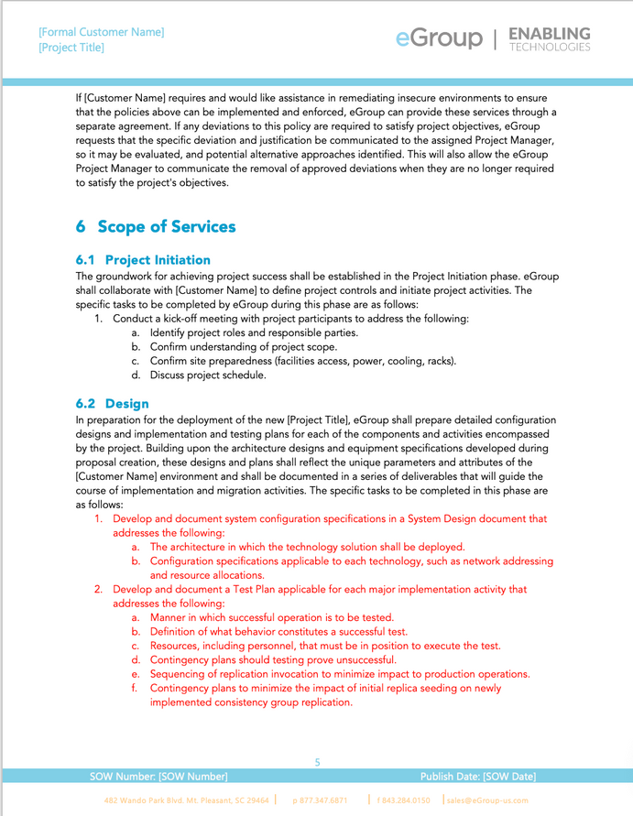

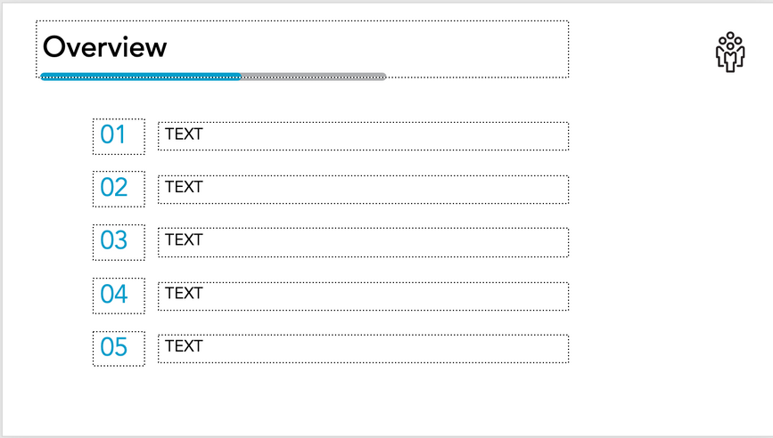
Word Documents and PowerPoint Presentations
Avenir “Book”
ENABLING TECHNOLOGIES
Avenir “Heavy”
Avenir “Black”
Avenir “Heavy”
Avenir “Book”
Avenir “Book”

Slide 15
BRAND LOGO
Primary
Logo
ENABLING TECHNOLOGIES
This is our core logo. You can use this logo on any company materials. We also have different logo variations of brand colors, depending on the background color being used.

Slide 16


LOGO VARIATIONS
ENABLING TECHNOLOGIES
ENABLING TECHNOLOGIES
ENABLING TECHNOLOGIES
ENABLING TECHNOLOGIES

Slide 17















Specialty Logos
More to come!
ENABLING TECHNOLOGIES
ENABLING TECHNOLOGIES
ENABLING TECHNOLOGIES
ENABLING TECHNOLOGIES
ENABLING TECHNOLOGIES
ENABLING TECHNOLOGIES
ENABLING TECHNOLOGIES
ENABLING TECHNOLOGIES

Slide 18
Logo Etiquette & Clear Space
Please don’t crowd the logo! Leave enough space for the logo so it can stand out and remain legible.
Avoid the below practices when applying logos to any materials.
ENABLING TECHNOLOGIES
ENABLING TECHNOLOGIES
X
X
X
Try not to shrink the
logo down to where “Enabling Technologies” is no longer legible.
Do not crop out “Enabling Technologies” without prior permission from Team Marketing.
Don’t publish any materials where the logo appears blurry or pixelated.

Slide 19
The Importance of Copy and Logo Usage with Contrast
It’s important for all of our readers to be able to easily read the content we share. In order to remain accessible to all audience members, it’s very important to utilize the principle of contrast.
By providing a clear contrast between the background and text colors, we can ensure our content is legible for our readers. Take note of the examples in the following pages to see best practices for using our logos on different background colors.

Slide 20
ENABLING TECHNOLOGIES
ENABLING TECHNOLOGIES
ENABLING TECHNOLOGIES
ENABLING TECHNOLOGIES

Slide 21



Partner Logo Examples
This is how you can showcase our partner logos over varying color backgrounds.
When co-branding, this is how our company‘s logo should be paired with partner logos.
|
|
ENABLING TECHNOLOGIES
ENABLING TECHNOLOGIES
|
|
ENABLING TECHNOLOGIES
ENABLING TECHNOLOGIES
|
|
ENABLING TECHNOLOGIES
ENABLING TECHNOLOGIES
|
|
ENABLING TECHNOLOGIES
ENABLING TECHNOLOGIES
|
ENABLING TECHNOLOGIES
|
ENABLING TECHNOLOGIES

Slide 22





People Icons
The eGroup Enabling Technologies people icons can be used interchangeably throughout documents, PowerPoint presentations, and additional marketing materials. They represent a major piece of our brand story...US!
The top group is representative of how we all work together to bring speed and certainty to our clients—symbolizing our tagline “Together We Make IT Happen.”
The smaller groups represent our various departments and specializations.
The bottom group is representative of how we as individuals control our work, therefore we as a team of individuals control our outcomes. This emphasizes the importance of “IT Is Up To Me,” referring to our own individual efforts in the service of the team.

Slide 23


















































Frequently Used Icons

Slide 24
#FFFFFF
#ADAEB0
BRAND COLORS
#FFE800
#FF9F24
#009ECC
#02637F
Color
Palette
#373939
#090909

Slide 25
Color Priority

Slide 26





Color Use
These principles are very important in order to provide materials that are accessible to all readers.
Color and contrast play a large role in the representation of information. In general, the icons and logos should be used in instances that provide the most contrast. Examples of approved color pairings are shown below.
ORANGE
BLUE
MUST BE BOLD
SOFT BLACK
WHITE
MUST BE BOLD
BLACK
GRAY
MUST BE BOLD

Slide 27






Social Media Channels
If you would like for Team Marketing to auto-post company page content to your LinkedIn CLICK HERE for instructions. Keeping a frequent stream of eGroup-branded content flowing amplifies our brand message, keeps your profile active with relevant updates, and ensures you’re aligned with the latest news and campaigns without needing to manage it manually.
LinkedIn
Instagram
Facebook
X
We have a YouTube channel, but we use it strictly to house Unlisted videos that are LIVE and gated on our website. By gating our content we’re able to better protect our intellectual property from our competitors, as well as see who exactly from our prospect and client contacts are viewing.
YouTube

Slide 28
Social Media Hashtags
#TogetherWeMakeIThappen
This is more than a hashtag, it’s a mindset.
At eGroup, we believe that the best outcomes happen when we come together as one team, with our solution partners, and alongside our clients. This hashtag reflects our collective effort to not only “make it happen,” but to make IT happen a play on words referencing delivering innovative technology solutions through collaboration, commitment, and community. By consistently using #TogetherWeMakeIThappen across our social posts, we reinforce our culture of teamwork because when we work together, anything is possible.
#SpeedAndCertainty
A classic value phrase inherited from eGroup referencing theA promise we make to our clients to deliver success promptly and reliably, working as quickly as possible to ensure that the work is done, but the work is also done properly. This is a great secondary hashtag to use alongside #TogetherWeMakeITHappen.
#ITIsUpToMe
#ITisUpToMe is a reminder that each of us plays a vital role in delivering exceptional IT services to our clients. This movement is about taking ownership, showing initiative, and recognizing that every individual contribution matters and your work makes a difference. Use #ITisUpToMe when sharing your achievements, milestones, or moments of impact—because together, we succeed when each of us steps up.

Slide 29
Social Media Hashtags
#weGroup
This hashtag represents the heart of who we are at eGroup– one team, united in purpose, working together to help our clients leverage technology for business success. It's about collaboration, shared success, and the belief that when we lift each other up, both in and out of the office, we can achieve extraordinary things. Together, we’re not just building solutions, we’re building a culture of inclusion, support, and impact. #weGroup
#BetterTogether
#ThePowerOfPartnership
This hashtag represents the strength and success we achieve through close collaboration with our solution partners. These are used to highlight our co-sell solutions, joint wins, and the value we bring to clients by working side-by-side with our partners. Together, we combine expertise, innovation, and aligned goals to deliver greater impact, because real results happen when we work better together. Feel free to use these when sharing about an in-person event with a partner, co-presenting a webinar together, or anything in reference to our partnerships.

Slide 30
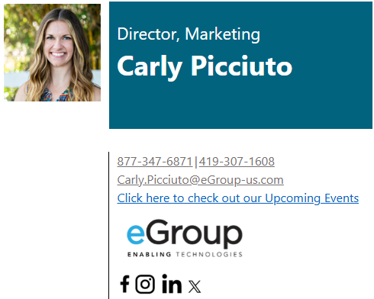

Email Signatures
Double-check your links before adding as your signature!
Logo of your choosing
Links to eGroup Social Channels
*Steps to insert your signature design into Outlook
*Signature Options

Slide 31
ENABLING TECHNOLOGIES
www.eGroup-us.com

